Slide 1
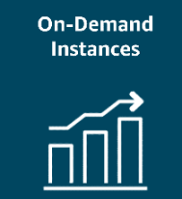
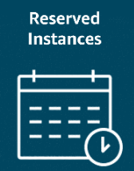
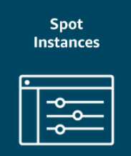

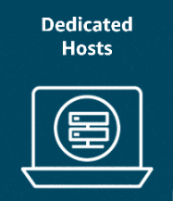

AWS pricing options

Slide 2
On-Demand Instances: Pay only for the compute capacity you consume with no upfront payments or long-term commitments required.
Reserved Instances: Get a savings of up to 75 percent by committing to a 1-year or 3-year term for predictable workloads using specific instance families and AWS Regions.
Spot Instances: Bid on spare compute capacity at up to 90 percent off the On-Demand price, with the flexibility to be interrupted when AWS reclaims the instance.
Savings Plans: Save up to 72 percent across a variety of instance types and services by committing to a consistent usage level for 1 or 3 years.

Slide 3
Dedicated Hosts: Reserve an entire physical server for your exclusive use. This option offers full control and is ideal for workloads with strict security or licensing needs.
Dedicated Instances: Pay for instances running on hardware dedicated solely to your account. This option provides isolation from other AWS customers.

Slide 4
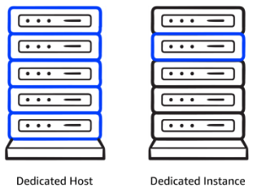
Dedicated Instances
Dedicated Hosts provide exclusive use of physical servers, offering full control over instance placement and resource allocation. This makes them ideal for security- or compliance-driven workloads. But what if you don’t need that level of control?
You could use Dedicated Instances, which offer physical isolation from other AWS accounts while still benefiting from the flexibility and cost savings of shared infrastructure.
The key difference is that Dedicated Instances provide isolation without you choosing which physical server they run on. Dedicated Hosts give you an entire physical server for exclusive use, providing complete control over instance placement and resource allocation.
Ultimately, the right choice depends on your specific workload requirements and the level of control you need over your infrastructure.

Slide 5
More about cost optimization
To optimize costs and resource allocation, AWS offers a range of pricing options including Savings Plans, Amazon EC2 Capacity Reservations, and Reserved Instances (RIs). Each of these is tailored to meet different workload and capacity needs.
1-Savings Plans :
Good for: Predictable workloads
Savings Plans offer discounts compared to On-Demand rates in exchange for a commitment to use a specified amount of compute power (measured per hour) over a one-year or three-year period. They provide flexible pricing for Amazon EC2, AWS Fargate, AWS Lambda, and Amazon SageMaker AI usage, regardless of instance type or AWS Region. Payment options include All upfront, Partial upfront, or No upfront.

Slide 6
More about cost optimization
2-Capacity Reservations:
Good for: Critical workloads with strict capacity requirements
With Amazon EC2 Capacity Reservations, you reserve compute capacity in a specific Availability Zone for critical workloads. Reservations are charged at the On-Demand rate, whether used or not. You only pay for the instances you run. This is ideal for strict capacity requirements for current or future business-critical workloads.
3-Reserved Instance flexibility:
Good for: Steady-state workloads with predictable usage
RIs offer up to 75 percent savings over On-Demand pricing by applying discounts across instance sizes and multiple Availability Zones within a Region. When you purchase a Reserved Instance (RI), AWS automatically applies the discount to other instance sizes within the same family based on the instance size footprint. It also applies the discount across multiple Availability Zones for enhanced resource distribution and fault tolerance

Slide 7
Directing Traffic with Elastic Load Balancing
Elastic Load Balancing
Elastic Load Balancing (ELB) automatically distributes incoming application traffic across multiple resources, such as EC2 instances, to optimize performance and reliability. A load balancer serves as the single point of contact for all incoming web traffic to an Auto Scaling group. As the number of EC2 instances fluctuates in response to traffic demands, incoming requests are first directed to the load balancer. From there, the traffic is distributed evenly across the available instances.
Although ELB and Amazon EC2 Auto Scaling are distinct services, they work in tandem to enhance application performance and ensure high availability. Together, they enable applications running on Amazon EC2 to scale effectively while maintaining consistent performance.

Slide 8
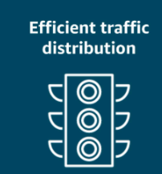
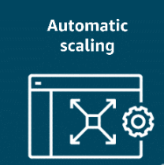
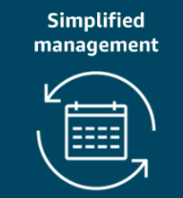
Directing Traffic with Elastic Load Balancing
Key takeaways: ELB benefits

Slide 9
Directing Traffic with Elastic Load Balancing
Efficient traffic distribution:
ELB evenly distributes traffic across EC2 instances, preventing overload on any single instance and optimizing resource utilization.
Automatic scaling:
ELB scales with traffic and automatically adjusts to changes in demand for a seamless operation as backend instances are added or removed.
Simplified management:
ELB decouples front-end and backend tiers and reduces manual synchronization. It also handles maintenance, updates, and failover to ease operational overhead.

Slide 10
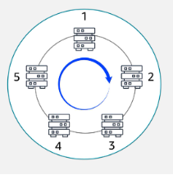
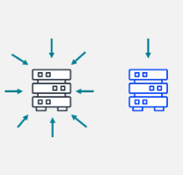
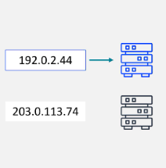
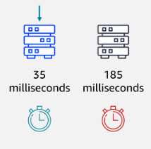
Routing methods
To optimize traffic distribution, ELB uses several routing methods: Round Robin, Least Connections, IP Hash, and Least Response Time. These routing strategies work together for efficient traffic management and optimal application performance.
Round Robin
Least Connections
IP Hash
Least Response Time

Slide 11
Routing methods
Round Robin:
Distributes traffic evenly across all available servers in a cyclic manner.
Least Connections:
Routes traffic to the server with the fewest active connections, maintaining a balanced load.
IP Hash:
Uses the client’s IP address to consistently route traffic to the same server.
Least Response Time:
Directs traffic to the server with the fastest response time, minimizing latency.

Slide 12
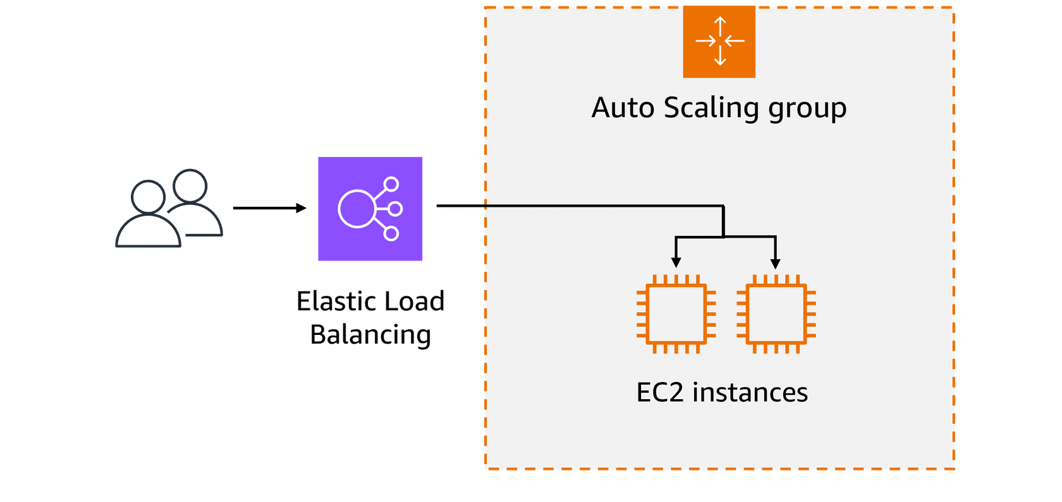
Example: Elastic Load Balancing
Let's look at an example to better understand how Elastic Load Balancing works in cloud computing. In the healthcare industry, particularly in hospitals and medical facilities that provide online appointment booking systems or patient portals, website traffic can vary greatly throughout the day.
Initial SetUp: Low-demand period: At the beginning of the day, only a few patients are accessing the system to book appointments or view medical records. The existing web servers are sufficient to handle the low traffic. This matches the demand, with no need for additional resources at this point.

Slide 13
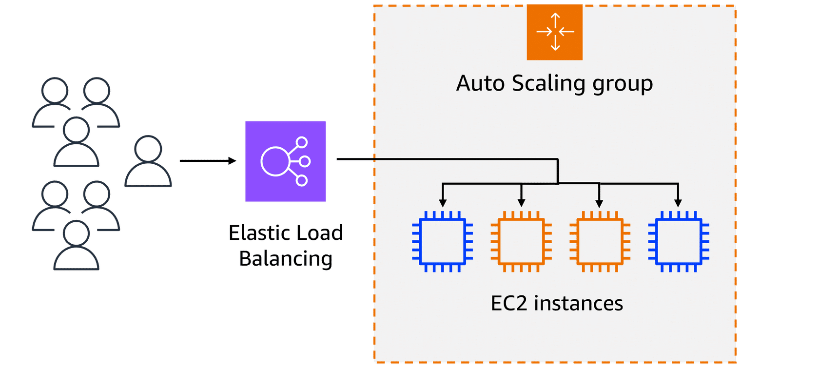
Example: Elastic Load Balancing
Scaling Up :Initial SetUp: High-demand period: As the day progresses, especially during peak hours, such as early mornings or just before the weekend, more patients access the portal to book appointments, view test results, or contact medical professionals. To handle this surge in demand, the healthcare system automatically scales up the number of servers to help ensure that the system remains responsive and available for all users.

Slide 14
Example: Elastic Load Balancing
Load Balancing: load balancer directs the incoming traffic to different web servers based on their current load. For instance, if one server starts receiving too many requests, the load balancer will route new requests to a less busy server. This makes sure that no single server becomes overwhelmed. The traffic is evenly distributed across available EC2 instances.

Slide 15
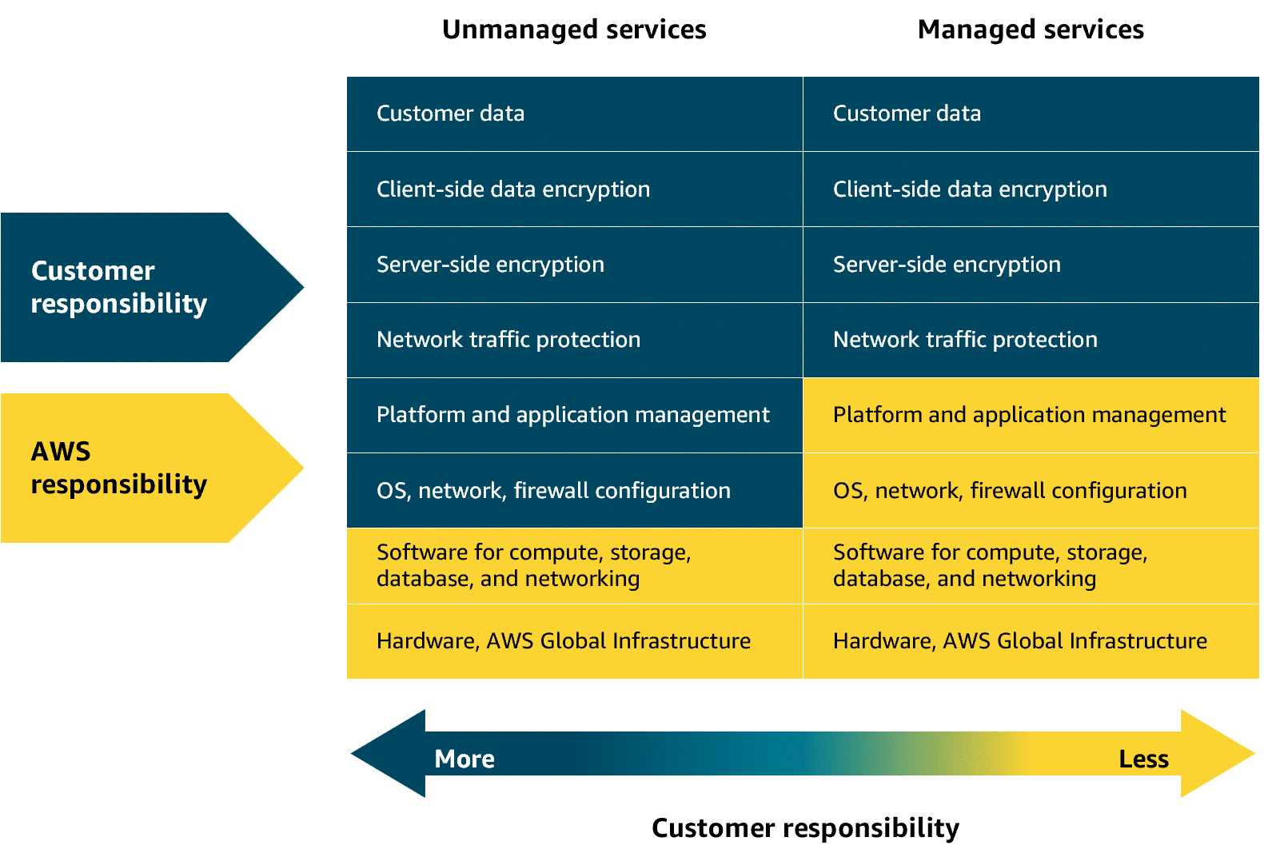
Unmanaged and managed services
With unmanaged compute services like Amazon EC2, AWS takes care of the underlying physical infrastructure, but you're responsible for setting up, securing, and maintaining the operating system, network configurations, and applications on your instances. Managed services, on the other hand, reduce the amount of infrastructure you need to manage. While AWS handles much of the operational overhead, you might still need to perform some provisioning or configuration depending on the service.

Slide 16
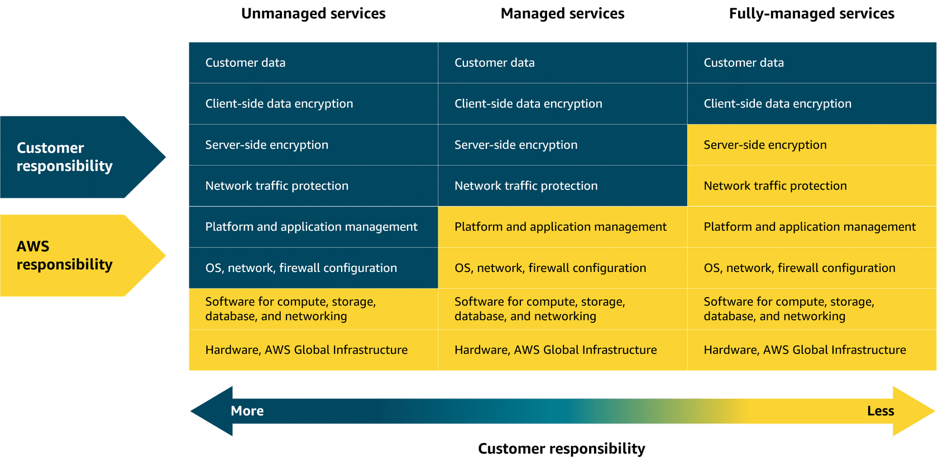
Fully-managed services
Fully-managed services—like serverless ones—take abstraction even further, eliminating the need to provision or manage any servers at all. The underlying infrastructure is fully managed by AWS, so you can focus entirely on writing and deploying code. Later in this module, you will explore Lambda. Lambda is a serverless compute service where AWS handles the infrastructure, scaling, and availability, while you remain responsible for securing and managing your application code.

Slide 17
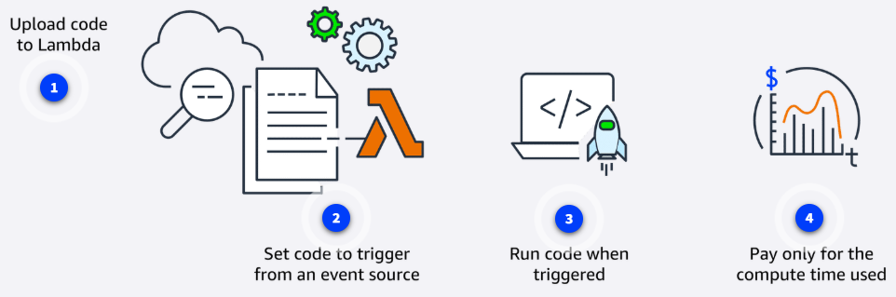
AWS Lambda
Lambda is a serverless compute service that runs code in response to events without the need to provision or manage servers. It automatically manages the underlying infrastructure, scaling resources based on the volume of requests. You are charged only for the compute time consumed, down to the millisecond. Lambda handles execution, scaling, and resource allocation. You can optimize performance by configuring the appropriate memory size for your function.

Slide 18
AWS Lambda
Upload code to Lambda
First, upload the code to Lambda, which uploads as a Lambda function.
Set code to trigger from an event source
Next, configure your code to be triggered by events, like AWS services, mobile apps, or HTTP requests.
Run code when triggered
Your code runs only when an event occurs, like a file upload or user action. Lambda automatically handles all the server management, scaling, and infrastructure. The Lambda runtime executes your function code using the event data passed to it. This way, your code runs reliably, securely, and efficiently—without you managing the servers or environment it runs in.
Pay only for the compute time used
You are charged only for the compute time consumed, down to the millisecond. The price depends on the amount of memory that you allocate to your function.

Slide 19
Lambda use cases
Real-time image processing for a social media application
A social media company uses Lambda to process images uploaded by users. When a photo is uploaded, Lambda is triggered to resize the image, apply filters, and save it in an optimized format to storage. This event-driven, serverless approach makes sure that the application can handle high volumes of uploads without needing to manage infrastructure.
Why Lambda: It automatically scales based on uploads and charges only for the time spent processing each image.

Slide 20
Lambda use cases
Personalized content delivery for a news aggregator
A news aggregator uses Lambda to fetch and process news articles from multiple sources, then it tailors recommendations based on user preferences. When a user opens the application or performs a search, Lambda functions are triggered to retrieve data, run personalization logic, and return relevant content.
Why Lambda: It automatically scales with user traffic and reduces costs by running code only when users interact.

Slide 21
Lambda use cases
Real-time event handling for an online game
A gaming company uses Lambda to handle in-game events like player actions, game state changes, and real-time leader board updates. Each event (like scoring a point or unlocking an achievement) triggers a Lambda function that updates player data and game status.
Why Lambda: It handles thousands of events, in real-time, with no need to manage servers. Costs scale with usage, which is ideal for peak gaming times.

Slide 22
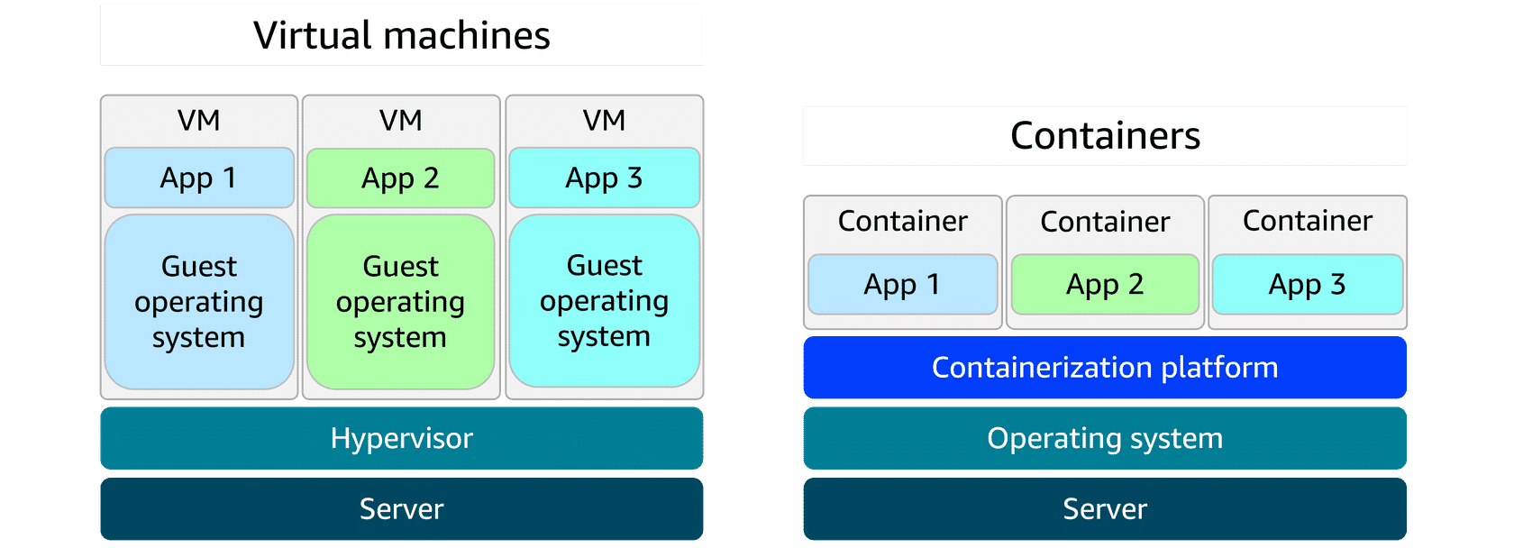
Solving deployment challenges
Containers and VMs
A container packages your application with everything it needs to run, so it works the same on any computer. This helps to move, update, and manage. Containers are faster and lighter than virtual machines (VMs) because they share the host computer’s operating system. VMs use a hypervisor to run full, separate operating systems, which makes them less resource-efficient and have longer startup times.

Slide 23
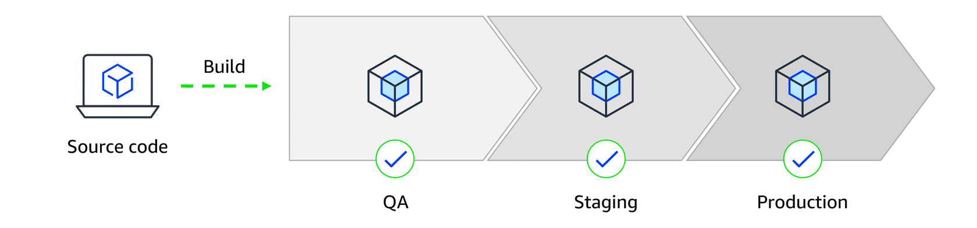
Solving deployment challenges
Deployment consistency with containers
When a developer’s environment differs from staging or production, deployments can fail and become difficult to debug. Containers solve this by keeping the application’s environment consistent everywhere, making deployments smoother and assisting troubleshooting.

Slide 24
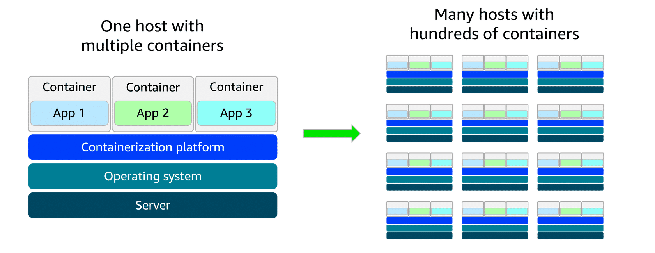
Solving deployment challenges
Scaling containers with orchestration
As containerized applications scale, managing them becomes more complex. A setup that began with a few containers on a single host can quickly grow into hundreds or thousands of containers across multiple hosts. At that scale, manually handling container lifecycle, monitoring, and general operations becomes unsustainable. This is where orchestration tools come in. They automate deployment, scaling, and management to keep everything running smoothly.

Slide 25
AWS container services
Amazon ECS
Amazon Elastic Container Service (Amazon ECS) is a scalable container orchestration service for running and managing containers on AWS, like Docker containers. Docker is a software platform for building, testing, and deploying applications quickly.
Amazon ECS launch types
Amazon ECS with Amazon EC2 is ideal for small-to-medium businesses that need full control over infrastructure. Suitable for custom applications requiring specific hardware or networking configurations, with the flexibility of Amazon EC2 and the simplicity of Amazon ECS.
Amazon ECS with AWS Fargate is perfect for startups or small teams building web applications with variable traffic. It's a serverless option—no server management required—so teams can focus on development while Amazon ECS handles scaling and orchestration.

Slide 26
AWS container services
Amazon EKS
Amazon Elastic Kubernetes Service (Amazon EKS) is a fully managed service for running Kubernetes on AWS. It simplifies deploying, managing, and scaling containerized applications using open-source Kubernetes, with ongoing support and updates from the broader community.
Amazon EKS launch types
Amazon EKS with Amazon EC2: This is best for enterprises needing full control over infrastructure. It offers deep customization of EC2 instances alongside Kubernetes scalability-ideal for complex, large-scale workloads.
Amazon EKS with AWS Fargate: This is great for teams wanting Kubernetes flexibility without managing servers. It combines Kubernetes power with serverless simplicity, helping to scale applications quickly across various use cases.

Slide 27
Amazon ECR
Amazon Elastic Container Registry (Amazon ECR) is where you can store, manage, and deploy container images. It supports container images that follow the Open Container Initiative (OCI) standards. You can push, pull, and manage images in your Amazon ECR repositories using standard container tooling and command line interfaces (CLIs).

Slide 28
Fargate
AWS Fargate is a serverless compute engine for containers. It works with both Amazon ECS and Amazon EKS. Fargate is a container hosting platform, unlike Amazon ECS and Amazon EKS, which are both container orchestration services.
When using Fargate, you do not need to provision or manage servers. Fargate manages your server infrastructure for you. You can focus more on innovating and developing your applications, and you pay only for the resources that are required to run your containers.

Slide 29
Additional compute services
AWS offers purpose-built services for specific needs, such as streamlining web application deployment, managing batch workloads, providing virtual servers, and extending cloud infrastructure to on-premises data centers.
Elastic Beanstalk
Elastic Beanstalk is a fully managed service that streamlines the deployment, management, and scaling of web applications. Developers can upload their code, and Elastic Beanstalk automatically handles the provisioning of infrastructure, scaling, load balancing, and application health monitoring. It supports various programming languages and frameworks, such as Java, .NET, Python, Node.js, Docker, and more. It provides full control over the underlying AWS resources while automating many operational tasks.
Good for: Deploying and managing web applications, RESTful APIs, mobile backend services, and microservices architectures, with automated scaling and simplified infrastructure management

Slide 30
Additional compute services
AWS Batch
AWS Batch is a fully managed service that you can use to run batch computing workloads on AWS. It automatically schedules, manages, and scales compute resources for batch jobs, optimizing resource allocation based on job requirements.
Good for: Processing large-scale, parallel workloads in areas like scientific computing, financial risk analysis, media transcoding, big data processing, machine learning training, and genomics research

Slide 31
Additional compute services
Lightsail
Amazon Lightsail is a cloud service offering virtual private servers (VPSs), storage, databases, and networking at a predictable monthly price. It’s ideal for small businesses, basic workloads, and developers seeking a straightforward AWS experience without the complexity of the full AWS Management Console.
Good for: Basic web applications, low-traffic websites, development and testing environments, small business websites, blogs, and learning cloud services

Slide 32
Additional compute services
Outposts
AWS Outposts is a fully managed hybrid cloud solution that extends AWS infrastructure and services to on-premises data centers. It provides a consistent experience between on premises and the AWS Cloud, offering compute, storage, and networking components.
Good for: Low-latency applications, data processing in remote locations, migrating and modernizing legacy applications, and meeting regulatory compliance or data residency requirements

